Slide 1
Meet the code ninjas
Dean Narendra
Nikola Chobanov
Tao Hua
Coen Stange
Bilger Yahov

Slide 2
Introduction

Slide 3

TODO: introduction

Slide 4
Way of working

Slide 5
“Great things in business are never done by one person,
they are done by a team of people”
–Steve Jobs

Slide 6
TODO: way of working

Slide 7
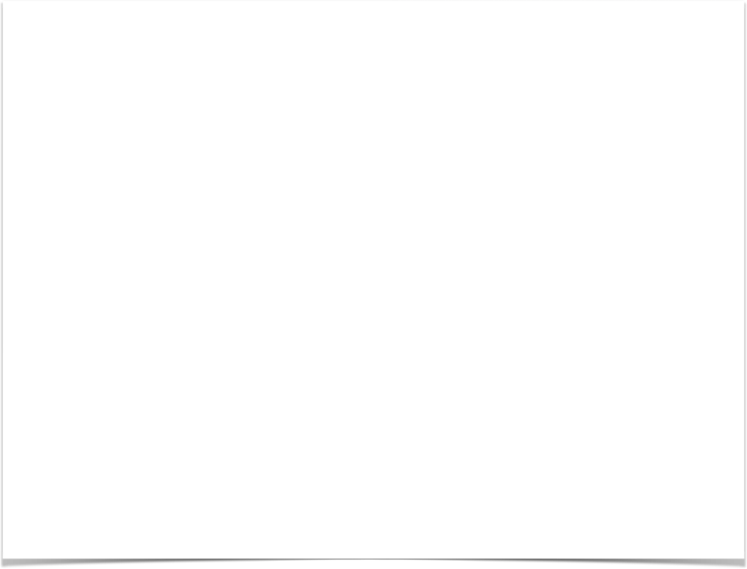
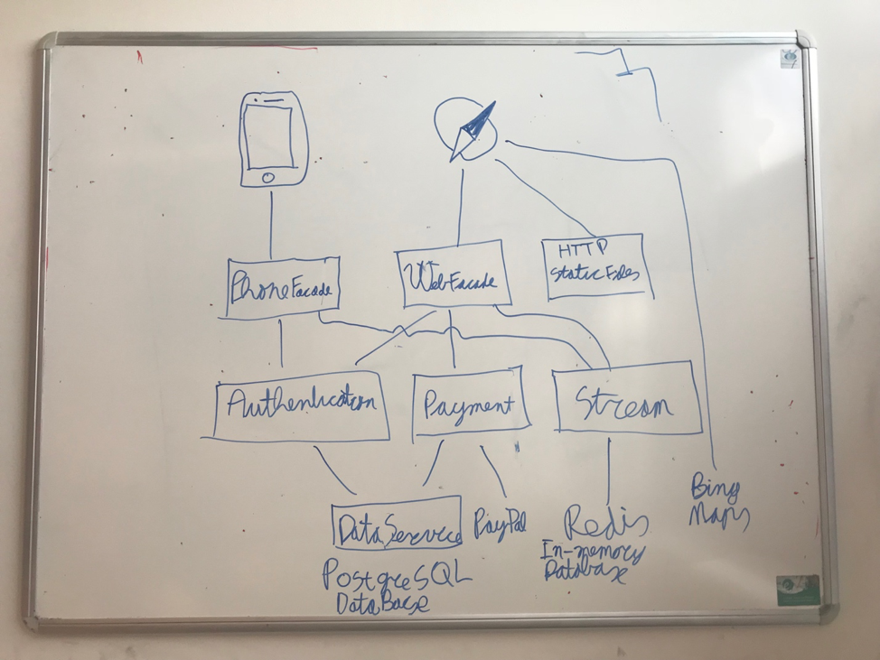
Software architecture

Slide 8
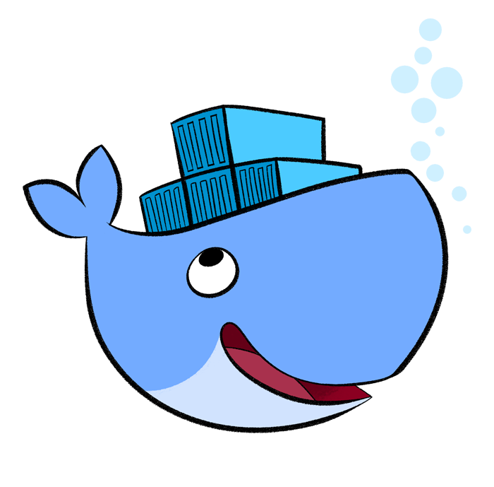
Docker
Make distributed system more easy!
Each application runs inside a container
Publicly available containers like PostgreSQL and Redis
Run the whole system and test the whole system
No need of mock tests, no problems with compatibility in production

Slide 9

Travis-Ci
Continuous integration
Tests triggered by commits
Automatic deploy after passed tests

Slide 10


Current hosting
Distributed System
(Docker)
Static Files
(Web-app)

Slide 11

GraphQL
The better REST-api
Less round-trips to server
Client is less dependent on server
Client describes to the server what data it wants (Query language)

Slide 12
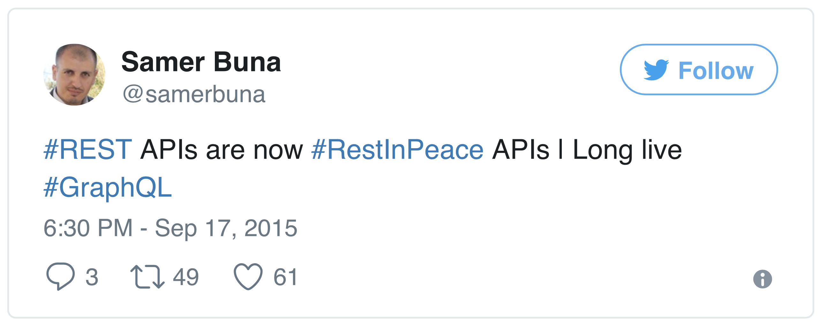

Slide 13


